Slide 1
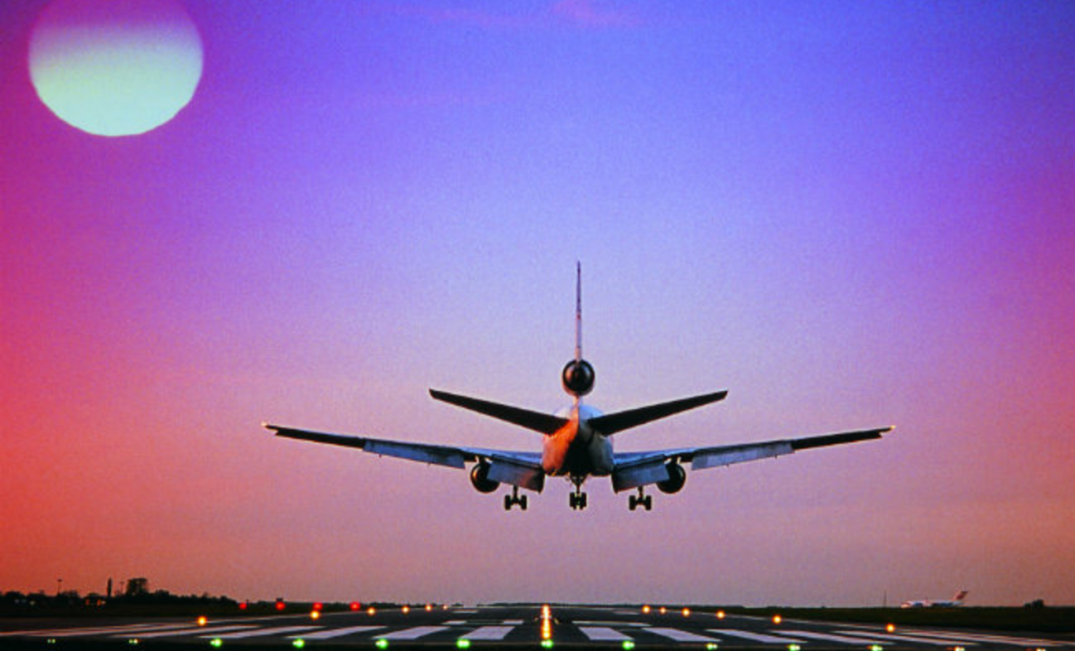
Predicting Airline Delay
DATA SCIENCE FINAL PROJECT
PRAKASH PATEL

Slide 2
PROJECT BACKGROUND
Airline Industry is a competitive business where the revenue generation greatly depends on different indices on which Airline are benchmarked
When it comes to Travel, on-time arrival is one of the most important factor every travel considers while planning for the next journey.
The goal of this project is to study the on-time Airline performance data provided by U.S Department of Transportation and predict the Arrival Delay.

Slide 3
Dataset Description
The dataset is taken from https://data.world/data-society/airlines-delay
This data contains the onetime performance data for all US Domestic Airlines for the year 2008
The Original dataset consists of
1936758 rows
30 Columns

Slide 4
Data Exploration
The dataset contains all basic information pertaining to a trip.
the dataset has different types of Airline Delay information.
CarrierDelay
WeatherDelay
NASDelay
SecurityDelay
LateAircraftDelay
Apart from these type of delay there is one more delay called the Arrival Delay
Basically a Flight is considered delayed if it had any Arrival Delay.

Slide 5
How to predict Airline Delay
While analyzing the data initially it could seem that the Airline delay could be predicted if there was one of the different types of delay.
However by further analyzing the data it is evident that there are more features which could be better interpreted and could be used to predict the delay.
Based on initial analysis it was planned to use below set of features for predicting Airline delay
Month
DayofMonth
DayOfWeek
UniqueCarrier
Origin
Dest
DepTime
ArrTime

Slide 6
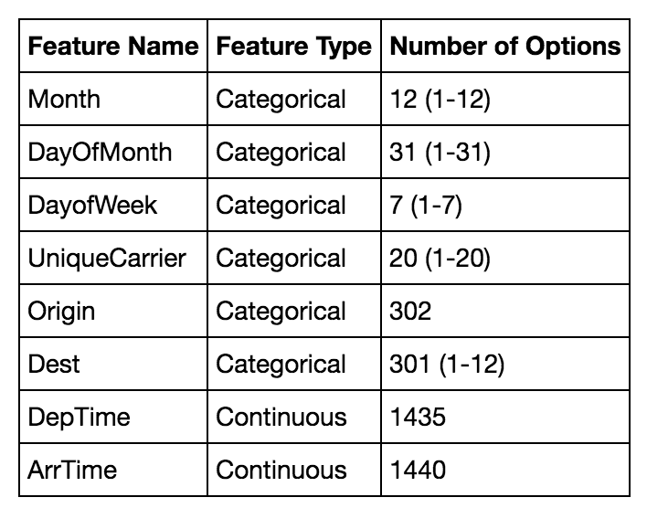
Exploratory Analysis of feature dataset
Building a model to predict the Airline Delay needs all of these options to be considered while building the model

Slide 7
Data Clean up
Data clean up was done on the original dataset from two different perspective.
Cleaning up data with null values. The dataset was reduced to 1247486 Rows X 30 Columns
Include only those columns which would be efficient to predict the delay with less redundancy.
DayofMonth was dropped to consider only Month
Origin field was dropped since Delay is considered only at the Destination Airport
Keeping in view the total number of Airports top 10 busy Airports were considered
Dataset size got reduced to 431487 X 48 columns (columns with dummy variables for features)

Slide 8
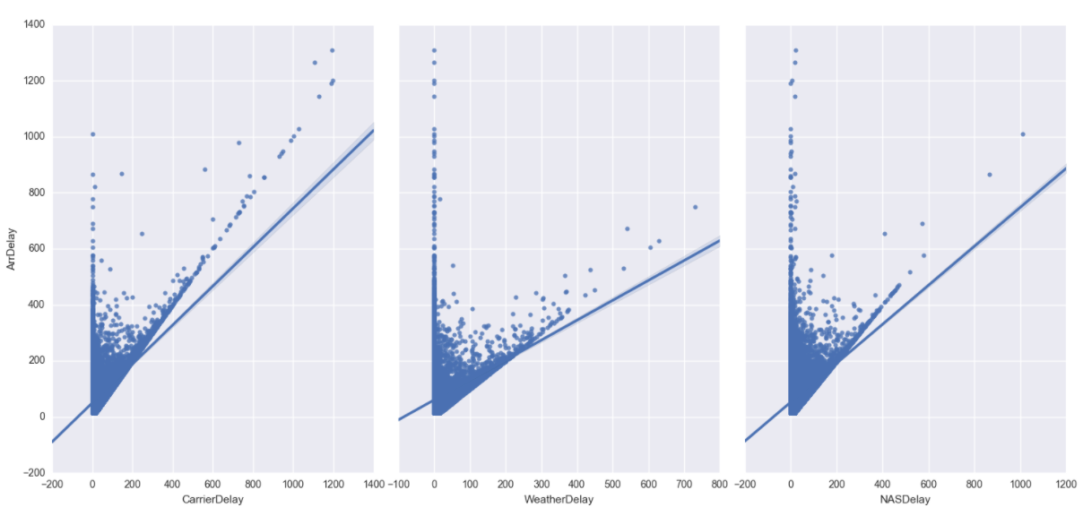
Analyzing how each of the delay affects Arrival Delay
Weather Delay seems to have a direct impact on overall Arrival Delay

Slide 9
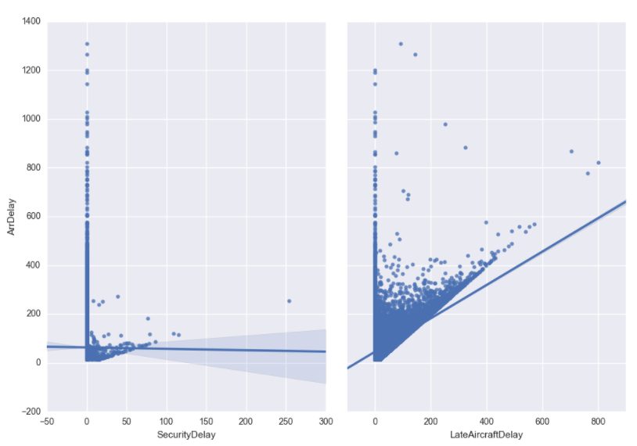
Analyzing how each of the delay affects Arrival Delay
While Late Airline Delay has some impact, SecurityDelay doesn’t seems to have any major impact on Arrival Delay

Slide 10
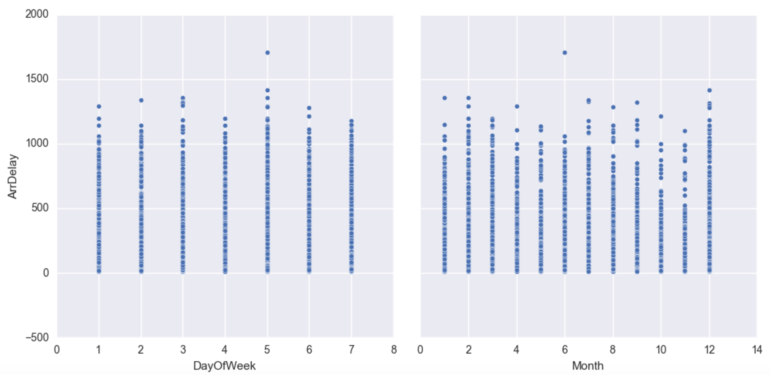
Analyzing Arrival Delay over DayOfWeek and Month
Friday seems to be the Day of the Week causing maximum Airline Delay while December Month has maximum Airline Delay

Slide 11
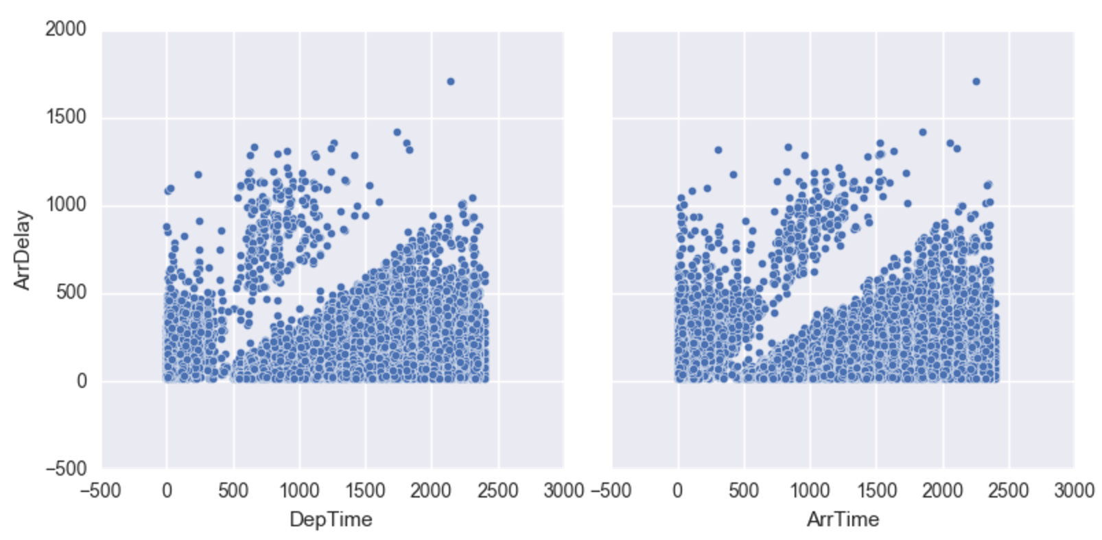
Analyzing Arrival Delay based on Departure and Arrival Time
Flights departing or arriving between 5 AM to 10 AM seems to have less Airline Delay. Late Departure or Arrival Flights tends to have more delays.

Slide 12
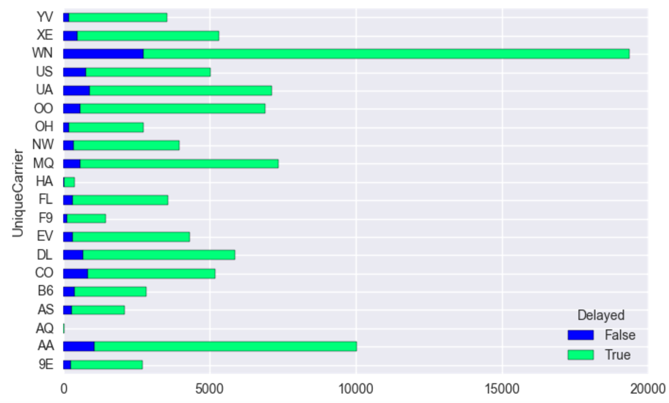
Analyzing number of Arrival Delay based on Carrier
Southwest Airline had the maximum number of delayed flights followed by American Airline

Slide 13
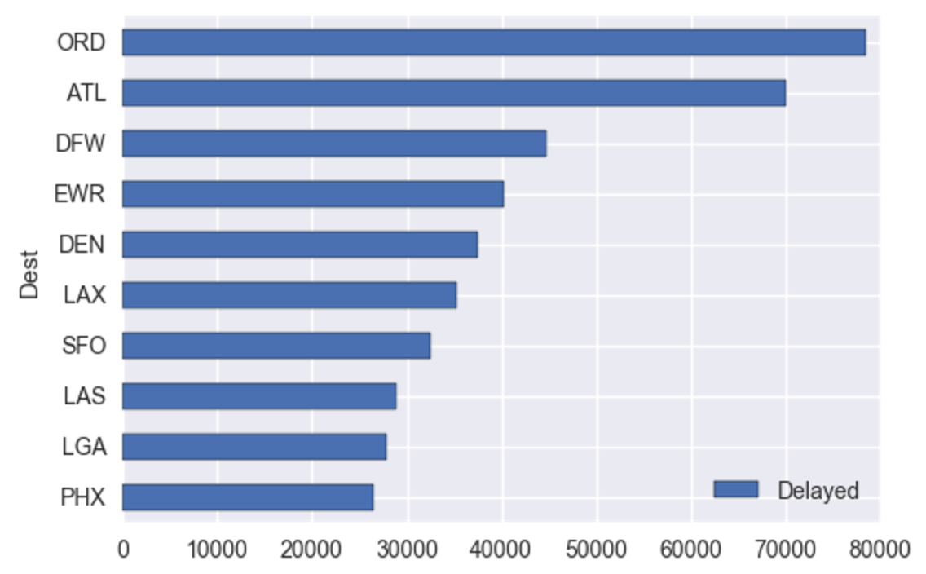
Analyzing number of Arrival Delay based on Airport
ORD Airport had the maximum number of delayed flights while PHX had the minimum number of delayed flights.

Slide 14
Modeling Approach
The goal of this analysis is to predict the Arrival Delay and quantify the delay interns of minutes.
From this perspective Linear Regression modeling is chosen
The features considered for training the model are
Month
Day Of Week
Unique Carrier
Destination Airport
Arrival Time
Departure Time
Output to be determined
Arrival Delay

Slide 15
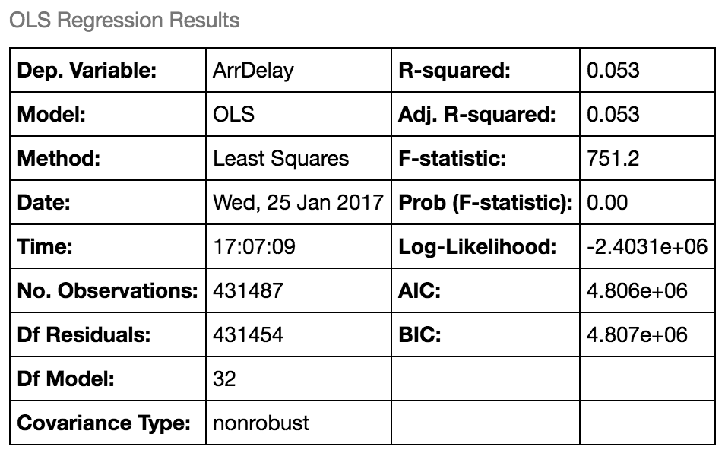
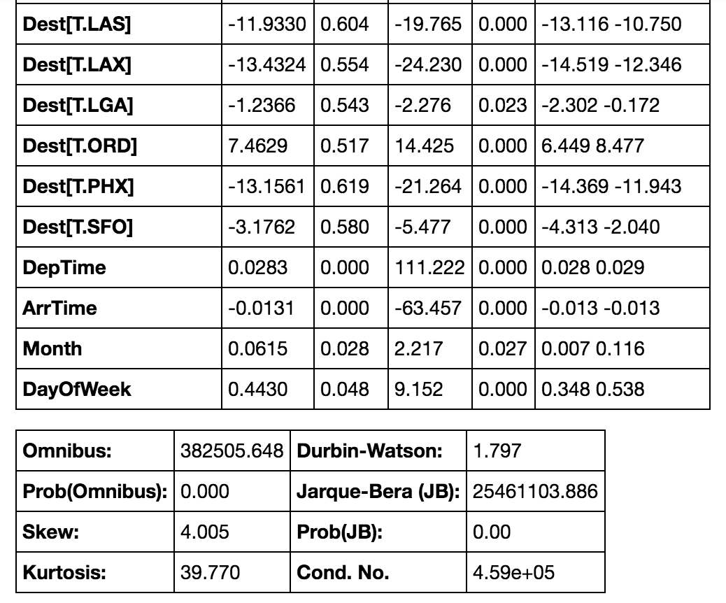
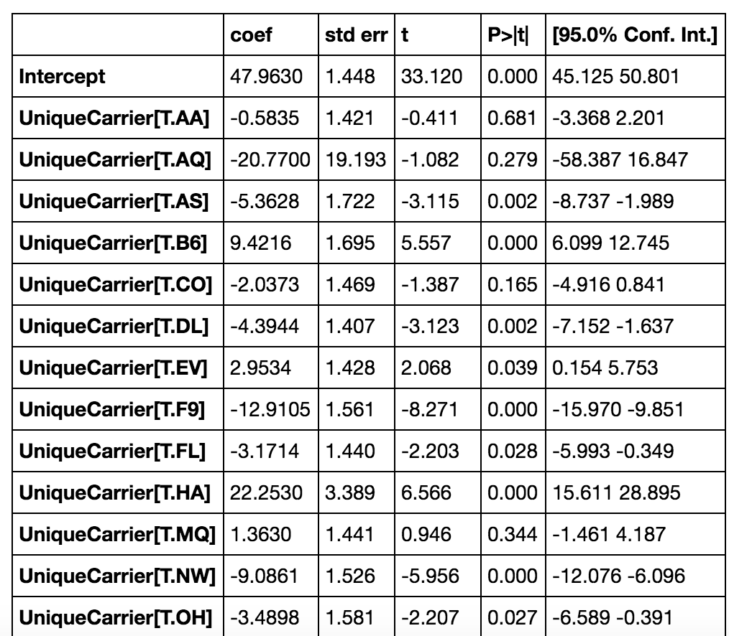
Model Analysis
Data Split is 75 - 25 between Train and Test data
p-values seemed good for most of the feature
R-Squared value didn’t looked good to be a candidate for regression model

Slide 16
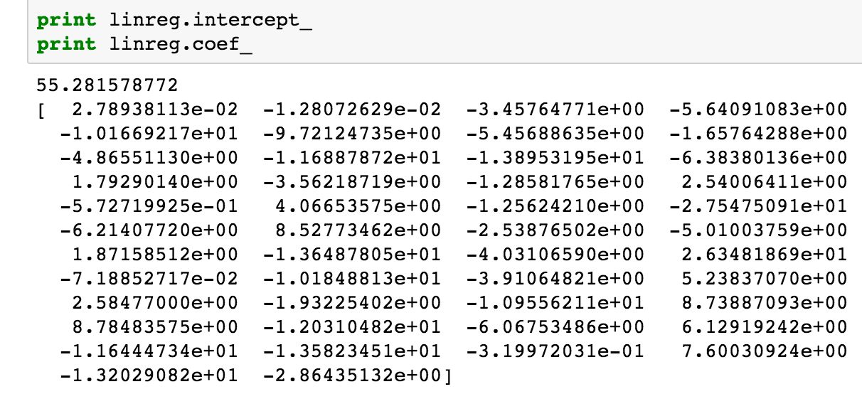
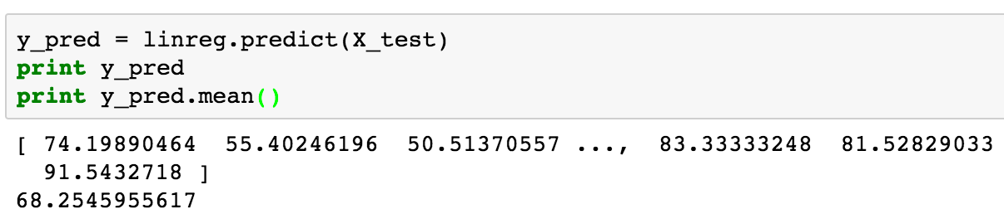
Analyzing Output
Based on the dataset used above predicted output was calculated
Caveat
This dataset contains all top busy Airports
While doing the clean up the final dataset used for analysis had all flights with a mime delay of 15 minutes.
Flight which had on-time or earlier arrival were not present in the dataset which would affect the average Arrival Time

Slide 17
What could have been better
Data clean up
The approach used to pick top 10 busy Airports was not the best approach to perform analysis. This highly impacted the arrival time as flights those were considered for analysis had a minimum delay time of 15 minutes
Model Fit
The dataset used for analysis ended up with having 48 columns including dummy variables.
Linear regression was not the best model to be used for these scenario. Random Forest could have been a better approach

Slide 18

THANK YOU
Hopefully I could predict your Arrival Delay next Time you Travel !

